Slide 1



RES EASY
RES EASY
RESERVATION EASY
USING JAVA
SUBMITTED BY:
AKUTHOTA RAKESH KUMAR

Slide 2

Manual restaurant reservations often lead to confusion and inefficiency.
Customers may miss out on tables due to lack of automation.
Our system solves this problem with an automated reservation system.
Features include auto-release of tables, waiting list management, and revenue tracking.
INTRODUCTION

Slide 3


Automate table reservations
Auto-release after reservation time
Maintain waiting list for customers
OBJECTIVES
Track daily revenue collection
Keep system simple & user-friendly

Slide 4

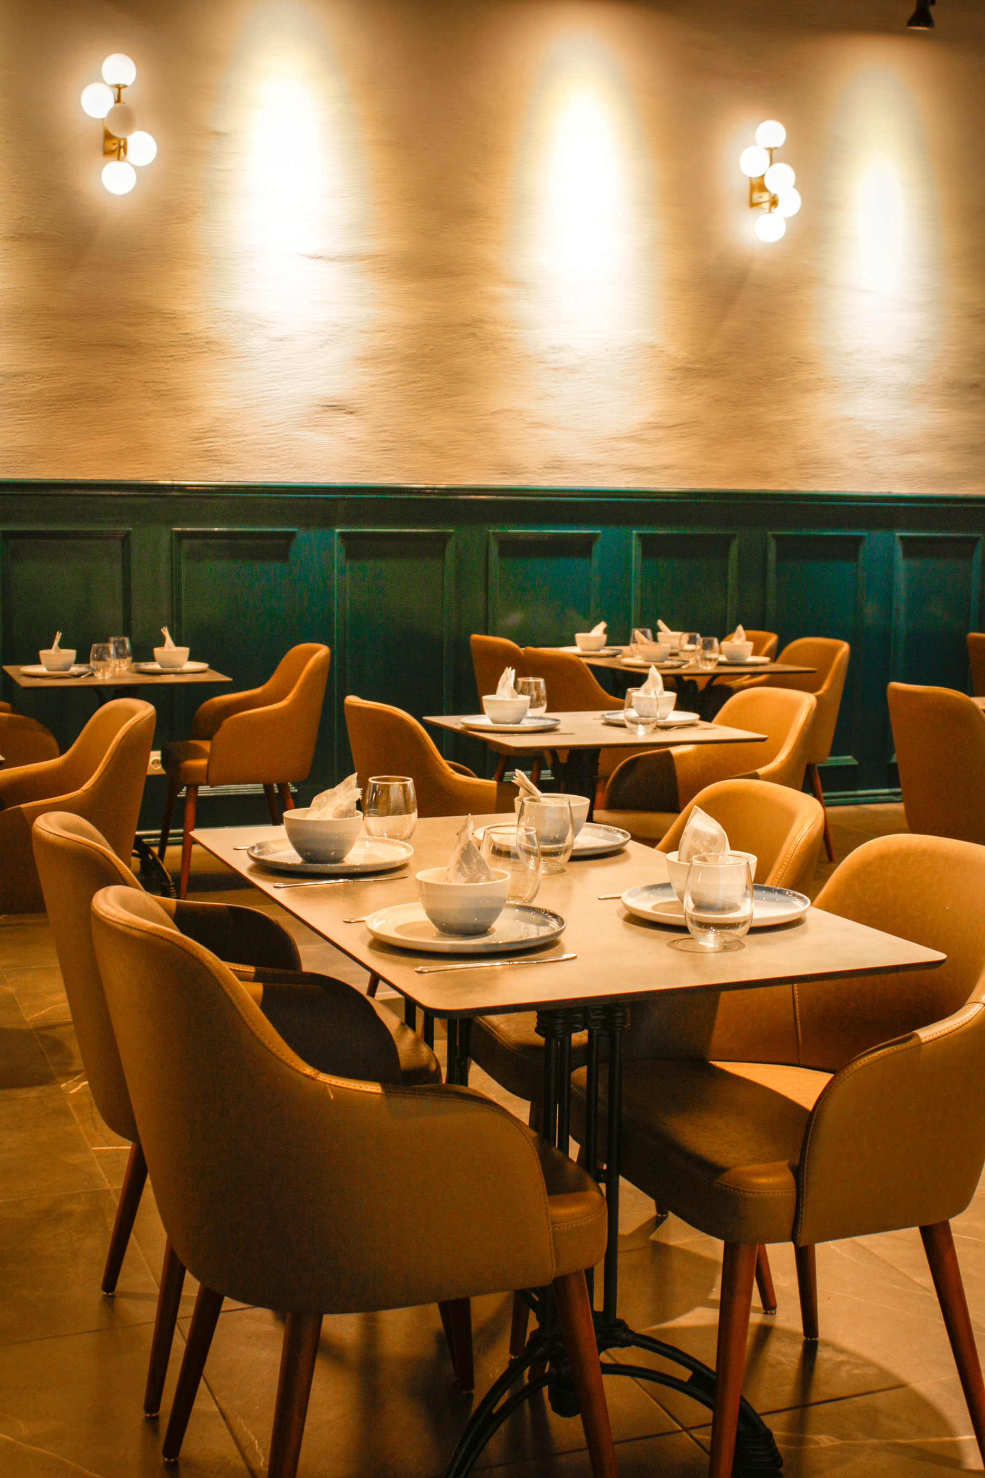
KEY FEATURES
Book, Cancel, and Force Release tables
Auto-release with Threading
Waiting list allocation
Charge calculation per person
File handling for reservation logs

Slide 5

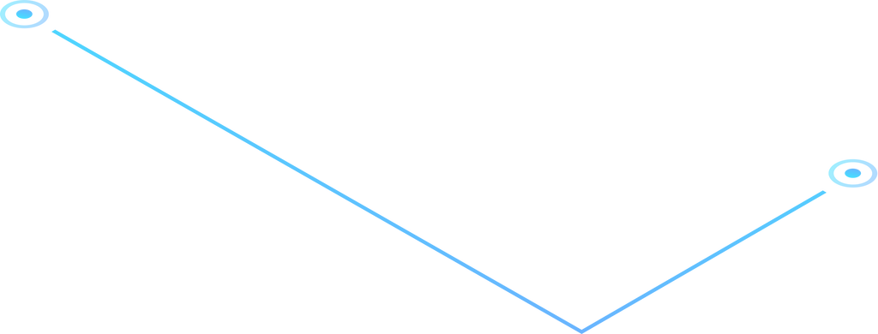
ADVANTAGES
Reduced manual effort
Fair allocation with waiting list
Automated billing & revenue tracking
Scalable & extendable design
Real-time updates

Slide 6

SYSTEM DESIGN
Restaurant
has-a list of Tables (Composition)
Table
encapsulates booking details
Interface (Reservable)
defines booking behaviors
Abstract Class (Person)
base for customer types
Threads
manage auto-release

Slide 7
TECHNOLOGIES USED
CSV Logging (Reservation History)
Collections (List, Queue for waiting list)
Java (Core OOP)
Threads, File Handling
Abstract, Interface

Slide 8
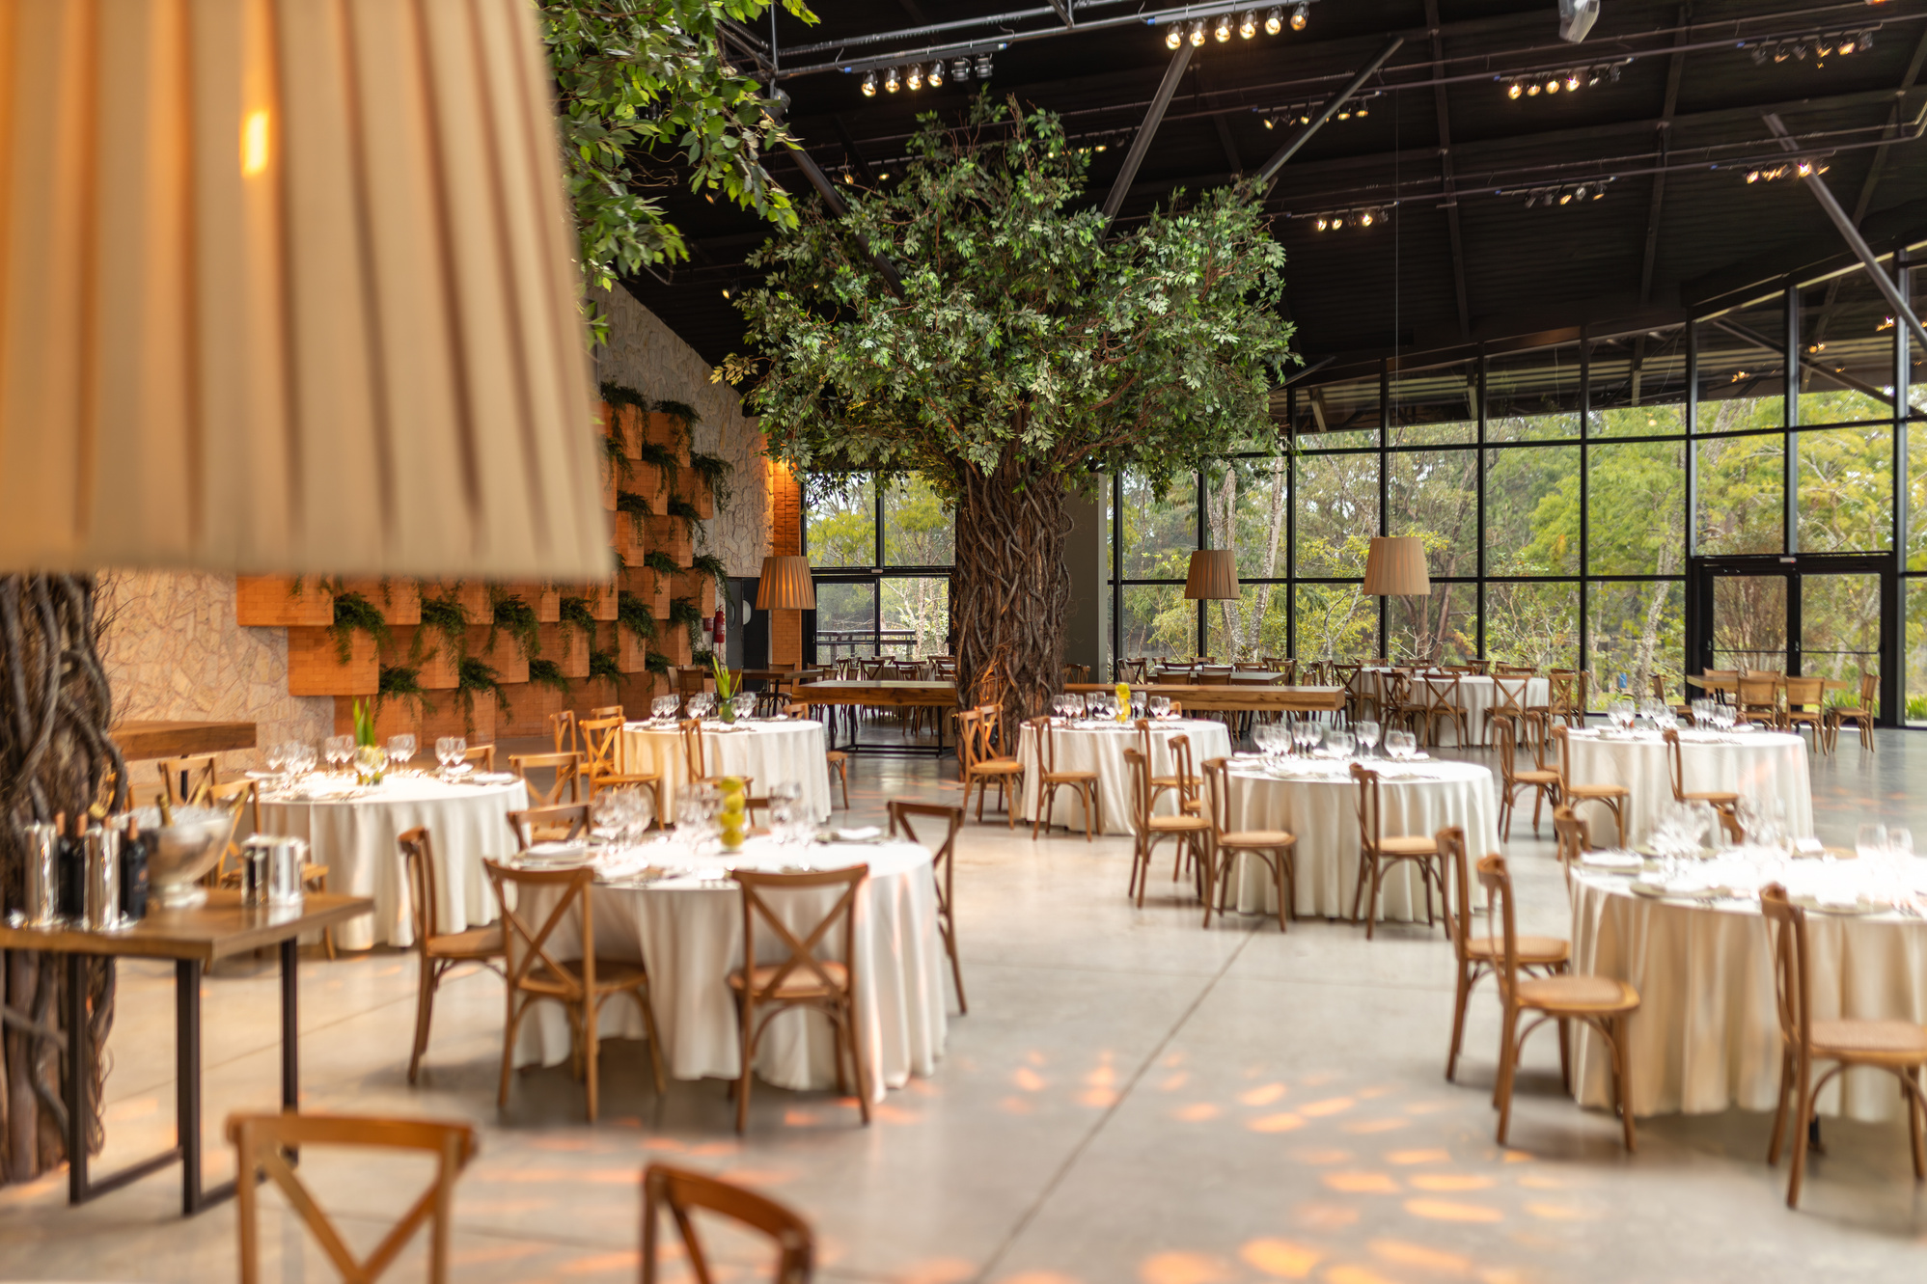

WORKFLOW
Customer requests reservation
System checks suitable table
If available → Allocate & start timer
If not available → Add to waiting list
On timeout / cancel → Auto-release & assign next in waiting list
Revenue updated in real-time

Slide 9

S – Single Responsibility
SOLID
PRINCIPLES
Each class has a clear role (e.g., Table manages booking details, Restaurant manages allocation).
O – Open/Closed
System is open for extension (add new table sizes, logging methods) but closed for modification.

Slide 10
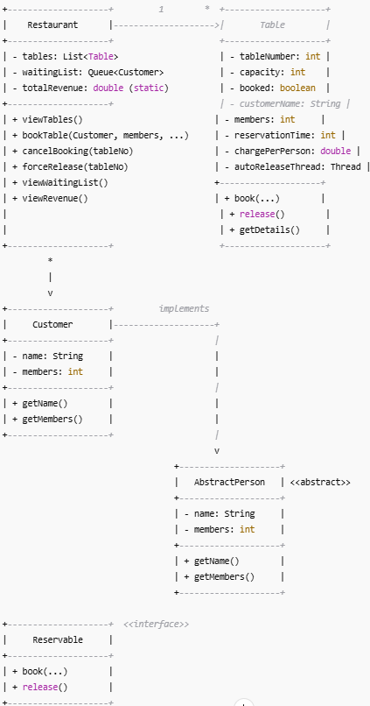
UML DIAGRAM

Slide 11
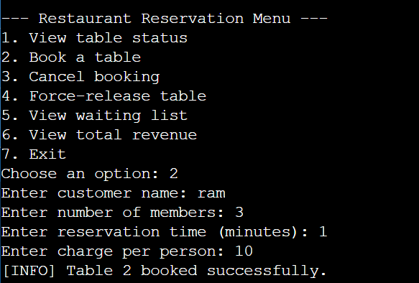
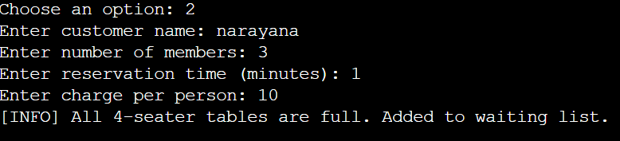
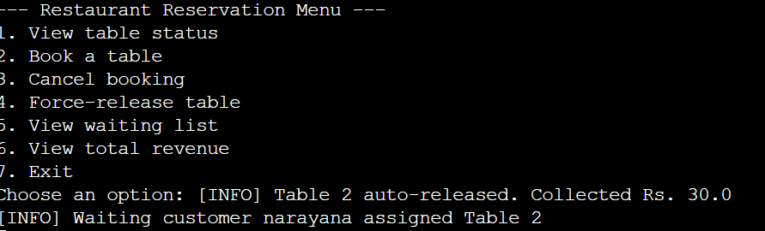
OUTPUT

Slide 12
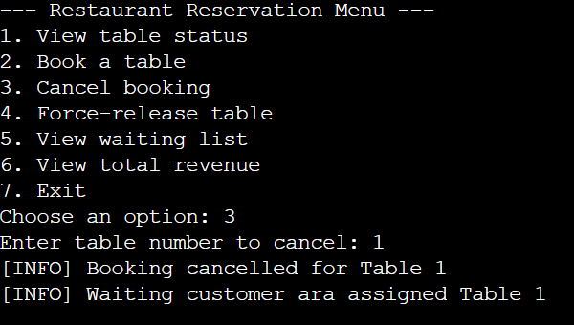
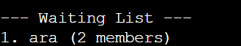
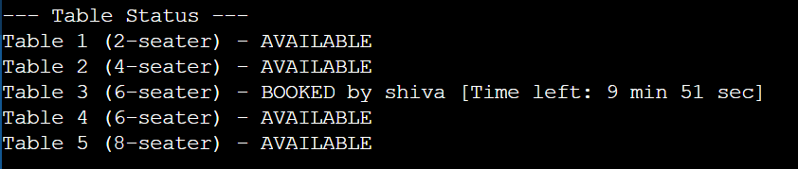
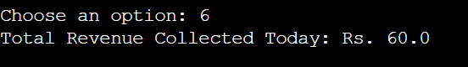
OUTPUT

Slide 13

THANK YOU!

